Slide 1

Welcome!
Presentation
Syllabus
Planning
The structure of the course
Questions, questions, questions 😨
COURSE START

Slide 2
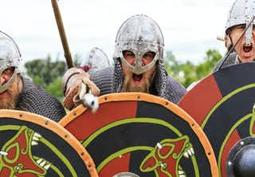
Global trade
The Viking Age
Years 800 – 1050
The population is increasing
Shipbuilder
Looting
Trade
Fur and leather
Amber
Timber
Slaves
Notes:
Scandinavia's population increased sharply at the same time as the art of shipbuilding developed.
This was a contributing factor to the first Viking raids, i.e. raids by Vikings,
boat-borne warriors from Scandinavia
June 8, 793, Vikings raided Lindisfarne monastery on the east coast of England
In the east, Norwegians sought their way down in large numbers along the Russian rivers
They loaded the ships with everything that could be turned into a profit, from tar and timber to silk and slaves.

Slide 3
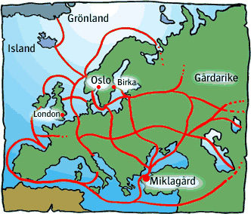
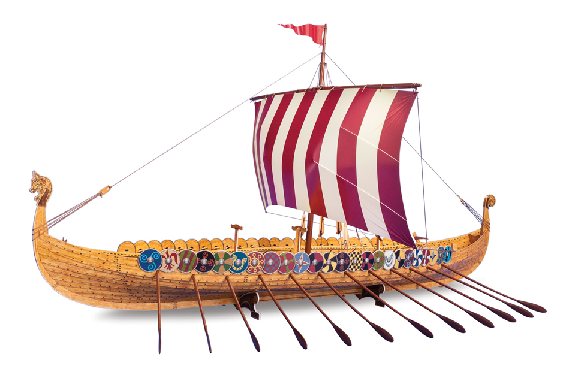

Slide 4
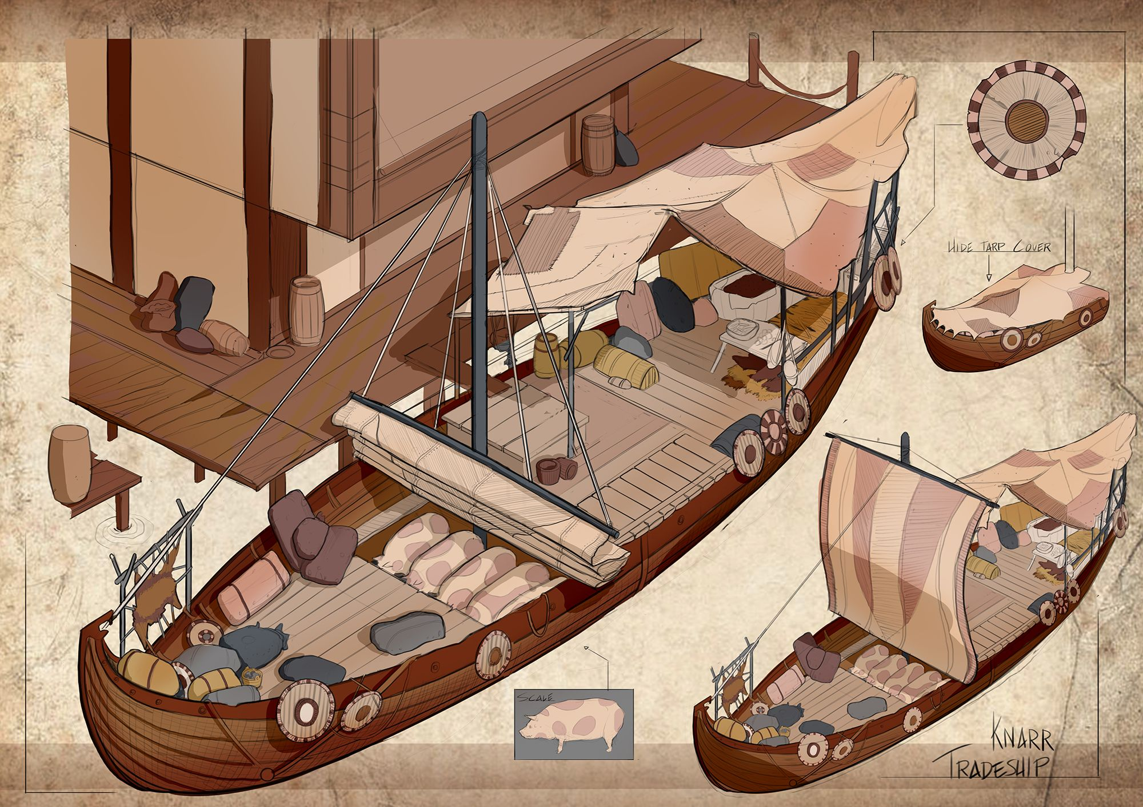
Global trade
Viking merchant ship
The cracker
16 meters long
Width 4.8 meters
90m2 sail
11 knots
19 ton load capacity
6 – 15 man crew
Notes:
Conduct trade
Transport in
A krarn was a type of ship that during the Viking Age was intended for trading trips across the sea.
The journeys across the Atlantic to Iceland, Greenland and Vinland are mainly assumed to have been made with crackers.
The creaker could also be fitted with a simpler form of tire.
While the longship was often rowed, the grunt was mainly intended for sailing.
The foundation of the entire trading empire was the versatile fleet of the Vikings.
On their flat-bottomed barges, the merchants could sail up and down the length without difficulty
The rivers of Eastern Europe and in 30 meter long ships they could safely cross the Atlantic with 35 tons of goods in the cargo.

Slide 5
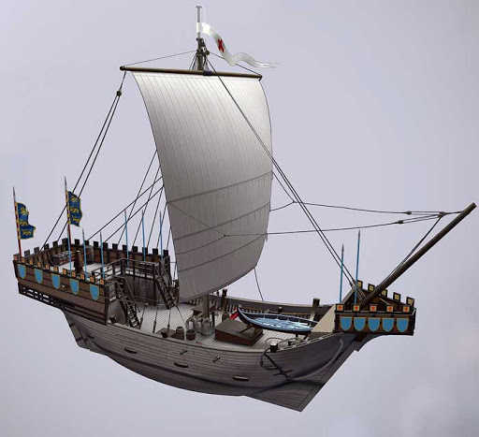
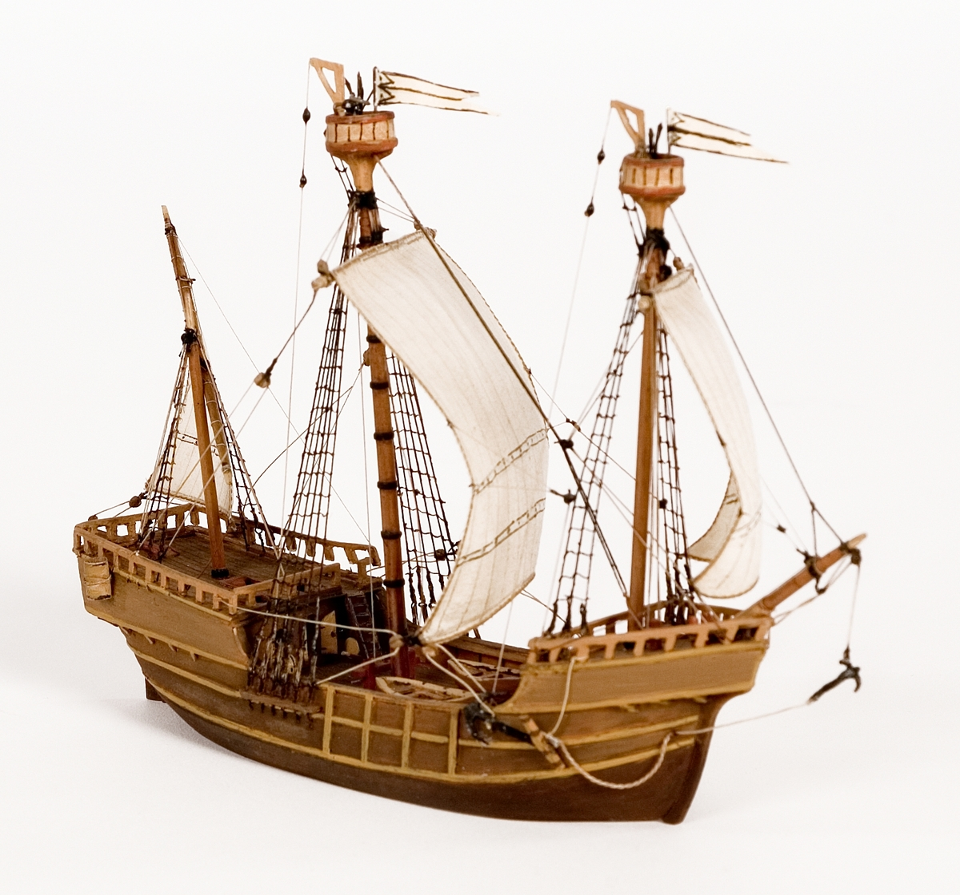
Global trade
The Hanseatic League
Middle Ages 14th century
Trade moves to cities
Customs duties
Ship
The cog
20 – 23 meters long, 5 – 7.5 m wide
80 ton load capacity
1 -2 masters
Seaworthy but poor sailing characteristics
5 – 9 knots
Notes:
The cog was at the time the main northern European ship construction.
For Hansan, it was important to make the ships as spacious as possible so that large profits could be achieved.
The original Norse Viking-type ships, on the other hand, were fast and could enter shallow beaches,
but these were, with the exception of the so-called creakers, not built to be able to take a larger quantity of goods on board.
With the keels, a completely new type of ship is introduced in northern Europe.

Slide 6
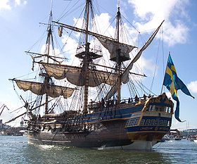
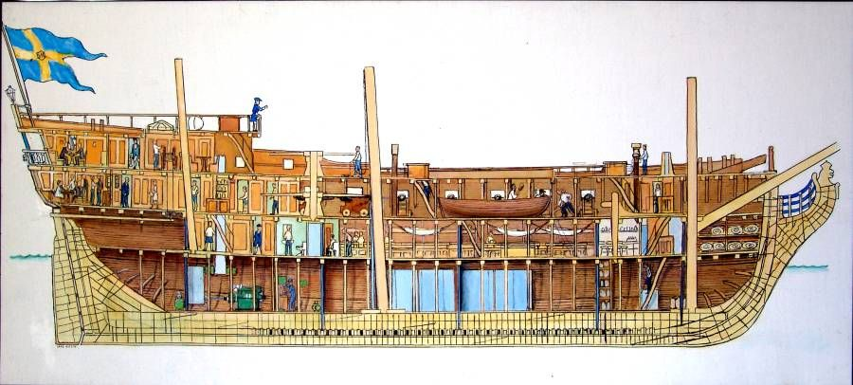
Global trade
East India Company 1731 - 1813
Gothenburg
Average speed 5-6 knots
Sail area 1900m2
Three trips
Launched in 1738
830 ton load capacity
144 man crew
30 guns
A soccer field is about 7000m2
Notes:
1587 Portuguese East India Company
1731 Privileges from the Swedish state
Oktroj = 15 year trading license
Colin Campbell, Niclas Sahlgren, Henrik König
132 expeditions
37 ships

Slide 7
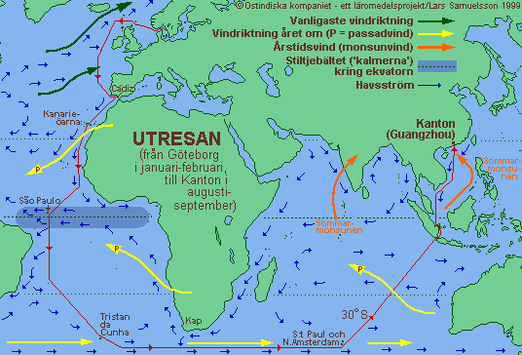
The trip out
Gothenburg - Cadiz Iron and wooden goods were exchanged for silver
In Canton, the silver was exchanged for tea, spices, silk and porcelain
Notes:
Trip 7 – 9 months
Jan/Feb arrived Aug/ Sept
Iron and wood from Sweden were exchanged in Cadiz in Spain for silver, which in turn was exchanged in Canton for tea, silk and porcelain.

Slide 8
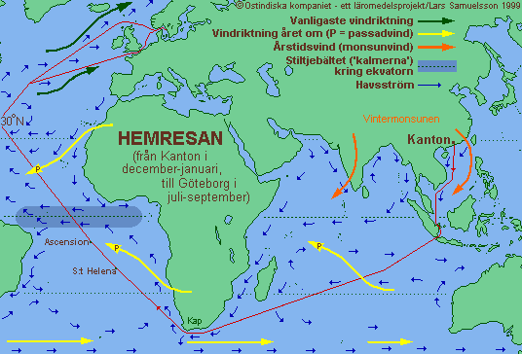
The journey home
The social impact of trade
Economically favorable
China's political system
Nature and Culture
New lifestyle habits
Notes:
7 – 10 months return home
Out Dec/Jan at home Christmas/ Sept
The company had exclusive rights to trade.
Big wins
Tax revenue to the state
China is politically stable and a model country
Researchers followed, Linné, knowledge transfer
Chinese culture becomes accessible through goods
Teahouse
Chinese gardens
Porcelain available for the middle class and below
A total of 37 ships (according to Kjellberg's ship list; others state 38) sailed out of Gothenburg on 130 voyages,
. On 118 trips, they came home happily from Canton and on two trips alone from India (1735 and 1742 respectively). 8 ships were wrecked, 5 on the outward journey and 3 on the homeward journey. .
The route from Gothenburg around Scotland to Cádiz :
just over 3,800 km or just under 2,060 nautical miles (nautical miles; a nautical mile is 1,852 m)
The distance from Cadiz to the Sunda Strait :
just over 20,700 km or almost 11,200 nautical miles
The distance from the Sunda Strait to Canton:
approx. 3400 km or 1835 nautical miles.
In total, this will be almost 28,000 km or 15,120 nautical miles.
If the winds were unfavorable, the distance could be significantly longer.
Wallenberg's ship Finland was blown by a severe storm from one point
west of the Shetland Islands back as far as southern Norway,
while Brelin's ship first ended up in Elsinore, before they finally managed to get out of the Kattegat!
382 sailing days out of a total of 551
367 sailing days out of a total of 564.
They actually did! Merchant ships in the 18th century were very bad at sailing against the wind direction. Therefore, they must choose a course so that they either had the wind or the current with them, preferably both
Most sailed from Gothenburg in January or February, a few in December or March.
This was not because it was a particularly good time to sail then, on the contrary.
In winter, the wind on the West Coast usually blows from the west or northwest, and then the ships could not get out.
But when there is an easterly wind in the winter it gets cold, and then the ships often get stuck in the ice and have to be sawed out!
In addition, the sailors froze terribly on board the completely unheated ships.
But you have to reach the Sunda Strait between Java and Sumatra by the beginning of September at the latest,
because in October the wind (monsoon) turns, so it was not possible to sail on to Canton!
And that journey took at least six months at best. So if you hadn't left Gothenburg at the very latest in April, it was better to wait until next winter.

Slide 9


Global trade
Trade cooperation - Free trade
NAPHTHA
USA, Canada and Mexico
APEC
Asian Pacific Economic Cooperation
WTO
World Trade Organisation
Organizes trade agreements between countries
Remove trade barriers
Simplify trade between countries
EU
Free movement of goods and services
No customs within the EU
Customs with countries outside the EU
Notes:
Fair discussion
EU countries require, for example, countries in Africa that the goods must be duty free
When they are imported to countries in Africa
While African goods are subject to customs duties when imported into the EU

Slide 10
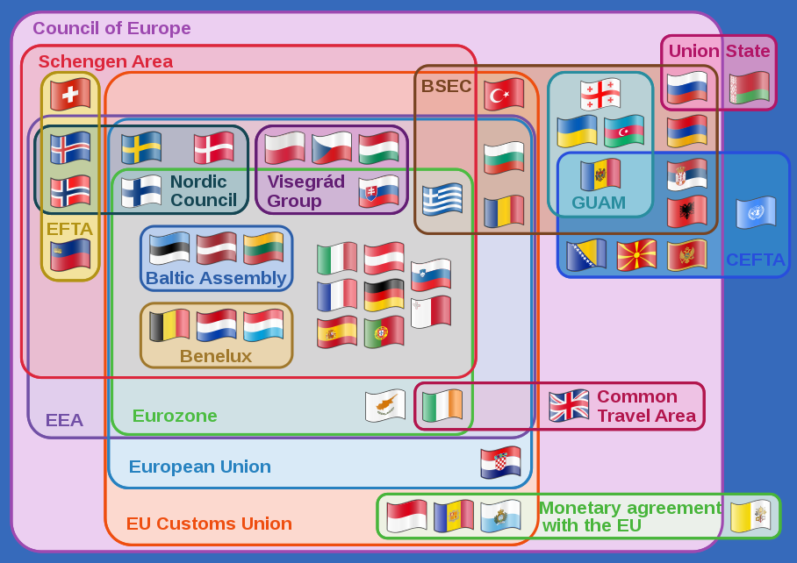
Council of Europe Europe council
Schengen area No entry and exit controls
EFTA European Free Trade Association
EEA European Economic Area
EURO zone EURO currency
European Union
EU Customs Union Customs Union
BSEC Black Sea Economic Cooperation
GUAM Organization for Democracy and Economic Development
CEFTA Central European Free Trade Agreement
Union State of Russia and Belarus
Visegrád group Poland, Czech Republic, Slovakia and Hungary
Baltic Assembly Estonia, Latvia and Lithuania
Nordic council Sweden, Norway, Denmark, Finland and Iceland
Benelux Belgium, the Netherlands and Luxembourg
Notes:
Within the Schengen area, the internal borders may be crossed everywhere without any entry or exit control being carried out, regardless of the person's nationality. However, customs controls and temporary internal border controls may occur.
European Free Trade Association European Free Trade Association
European Economic Area European Economic Area
BSEC The Organization for Economic Co-operation in the Black Sea Region

Slide 11

Global trade
International trade as a driving force
Community development
Technological advances
The global marketplace
More products
More sellers
More buyers
Logistics and transport systems
Developed in parallel with trade
Systems and infrastructure
Ports
Use of load carrier systems
Containers and trailers
Standardization of transport units
EUR platform
Contributes to increased availability of goods
Notes:
International trade has largely functioned as a driving force
for the general development of society.
At the same time, the development of society has created new conditions for trade.
Development has been promoted by several factors including technological advances,
which at the same time has also changed the way we conduct international trade.
The transport systems have evolved from simple boats to today's container ships
while communications have improved between buyers and sellers
using information technology solutions.
Due to the technological development and the increasing prosperity see
trade looks completely different today than just a few decades ago.
Today
there are more products, more sellers and more buyers around the world.
The world has developed into a global marketplace.

Slide 12
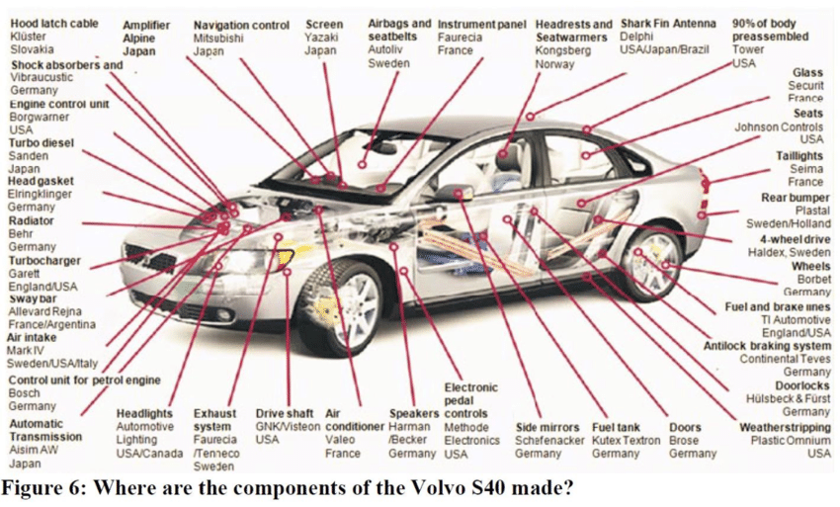

Slide 13
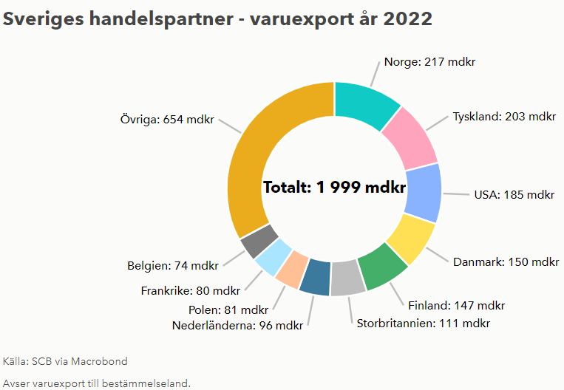
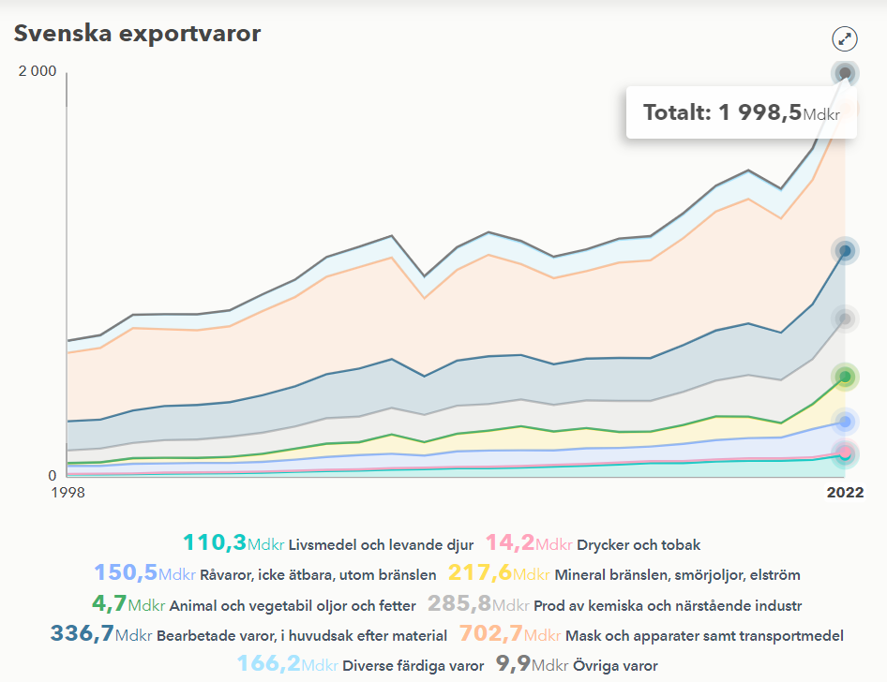
Global trade
Sweden's trade partners' export goods

Slide 14
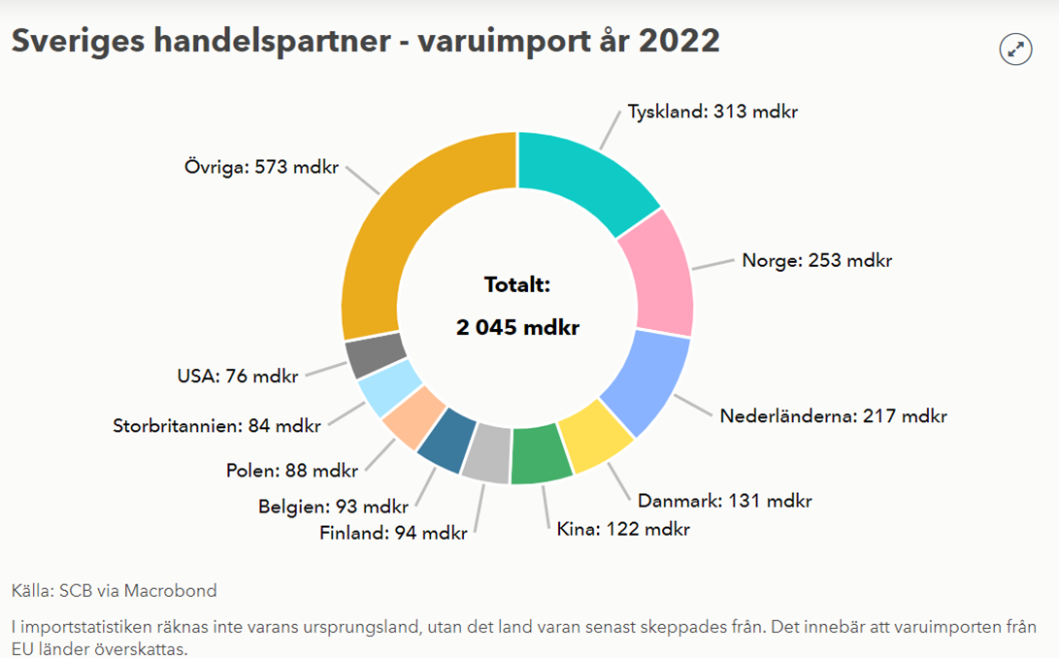
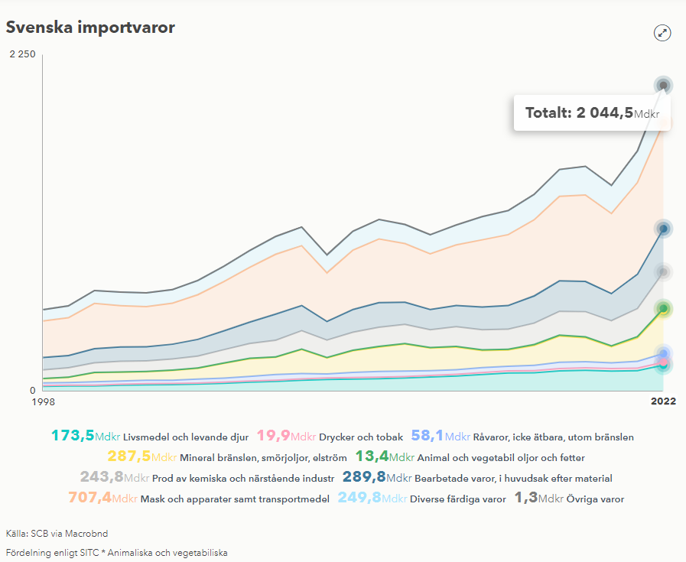
Global trade
Import goods of Sweden's trading partners

Slide 15
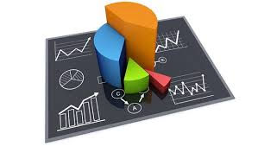
Global trade
Statistics 2022
Road transport to Sweden
About 15 million tonnes
Road transport from Sweden
16 million tons
About 80% of the vehicles are registered abroad
Sea transport to Sweden
About 81.2 million tonnes
Sea transport from Sweden
64.5 million tonnes

Slide 16

Global trade
Statistics 2022
To/from Swedish airports
Air transport to Sweden
64,000 kg
Air transport from Sweden
84,000 kg
A large part of air transport
Departs from airports in Europe

Slide 17
Discussing global trade
Free trade
Which nations benefit from free trade?
Give examples
Which nations are disadvantaged by free trade?
Give examples
Trade
What advantages and disadvantages are there with trade cooperation such as the EU?
Logistics
How is logistics affected by free trade?
Give examples
How are logistics affected by trade barriers?
Give examples

Slide 18
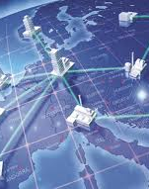
The word Logistics
Logistikos , Greek = skill in calculating
Logista / Logistika , Roman = the one who kept track of soldiers and supplies
Logistique , French = acquisition, storage and distribution of equipment in the military

Slide 19
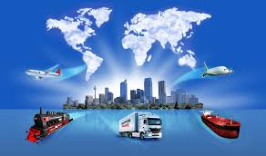
What is logistics?
The seven "R's" of logistics
right customer
right be on
right place in
right time in
the right amount with
right quality to
right price
Logistics' 8th "R"
the right environmental impact

Slide 20
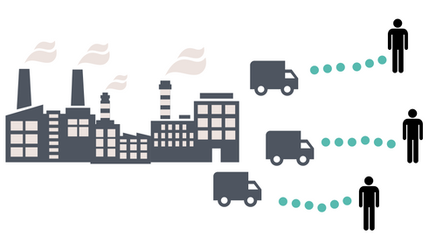
The forms of logistics
Production logistics
the manufacturing company's logistics
control of material flows
Distribution logistics
Planning and control of delivery from e.g. stock to end customer.
Third party logistics/ 3PL
The goods owner handing over responsibility of the whole or parts of the logistics
Stock and distribution
Fourth party logistics/ 4PL
Long term cooperation
IT integration

Slide 21
1PL
2PL
3PL
4PL
Product Owner/Manufacturer
Product Owner/Manufacturer
Product Owner/Manufacturer
Product Owner/Manufacturer
One party
The goods owner takes care of transport and logistics on his own
Two part
The goods owner takes care of the logistics in-house, but hires a carrier to carry out the transport
Third Party
The goods owner hires a logistics operator who takes care of storage, distribution and warehouse services as well as contact with the buyer
Fourth party
The goods owner hires an actor with third-party logistics services and is digitally involved in the process and contact with suppliers and the buyer
Buyer
Buyer
Buyer
Buyer
Parties = The goods owner
Parties = The goods owner and the transport pipes
Parties = The goods owner, the logistics operator and the buyer
Parties = The goods owner, the logistics operator, the supplier and the buyer

Slide 22
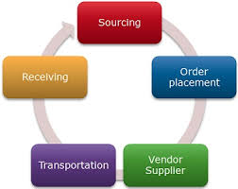
The forms of logistics
Purchasing logistics / Inbound logistics
Planning of purchase volumes
From suppliers to production or distribution.
Outbound logistics
Material flows from warehouse or production to the customer.
Reverse logistics, return logistics / Reverse logistics
Return flows
Incorrect goods
Regretted purchase
Used products for recycling

Slide 23
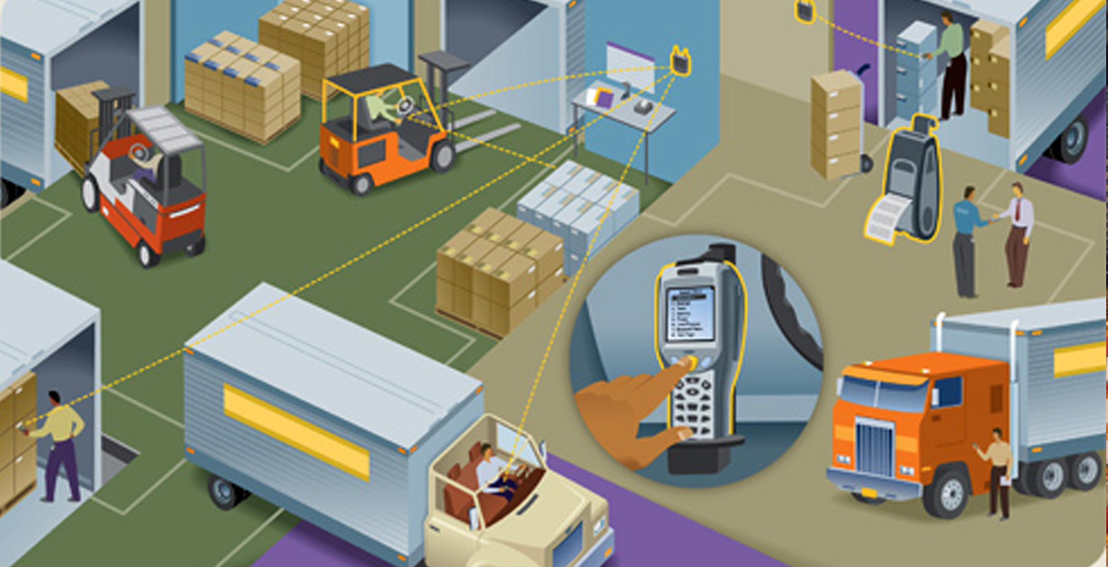
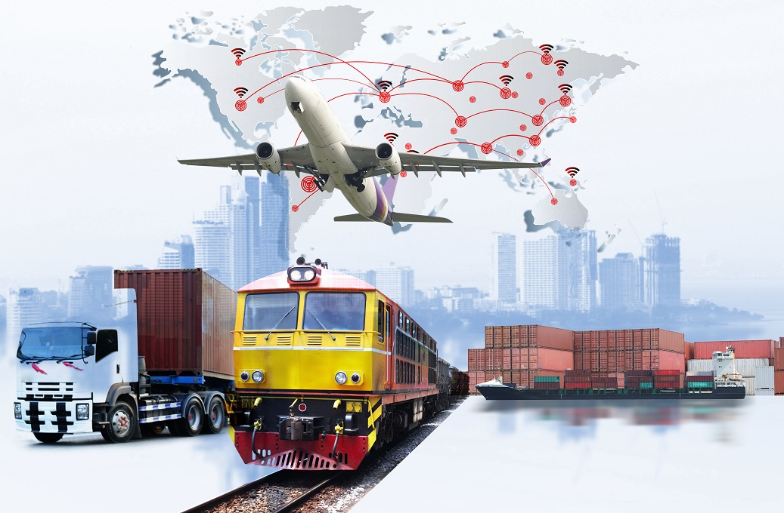
The forms of logistics
Transport logistics - travel agency for goods
Forwarding
Physical
Nationally
Internationally
Globally

Slide 24
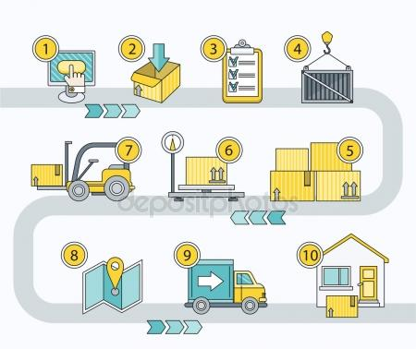
The forms of logistics
Transport logistics
Forwarding
Movement of an item
From
Sender
To
Receiver
Stock
Administration
Delivery monitoring
IT
Customs
Payment

Slide 25

Transport logistics
The forwarder/Logistics company
Arrange the transport export from SE
From
The goods owner/Consignor/Exporter
To
The Recipient/Customer
Arrange the transport import to SE
From
The Sender/Supplier
To
The goods owner/Recipient/Importer

Slide 26
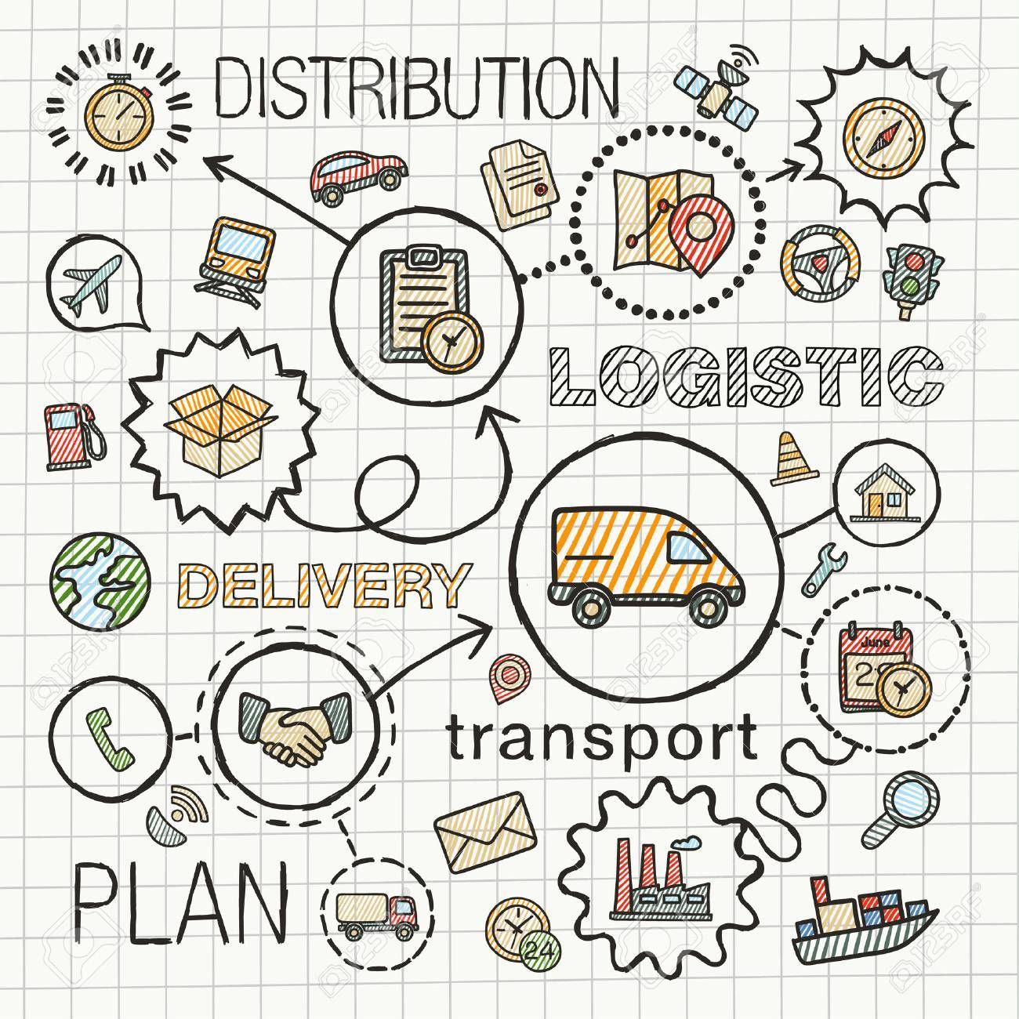
Logistics between companies
Focus area in teaching
Business between companies = goods owner
An item must be moved
Sellers and buyers of goods

Slide 27


Logistics company/Beehive
What is a logistics company?
Give three examples of logistics companies
Why are these logistics companies good examples?

Slide 28
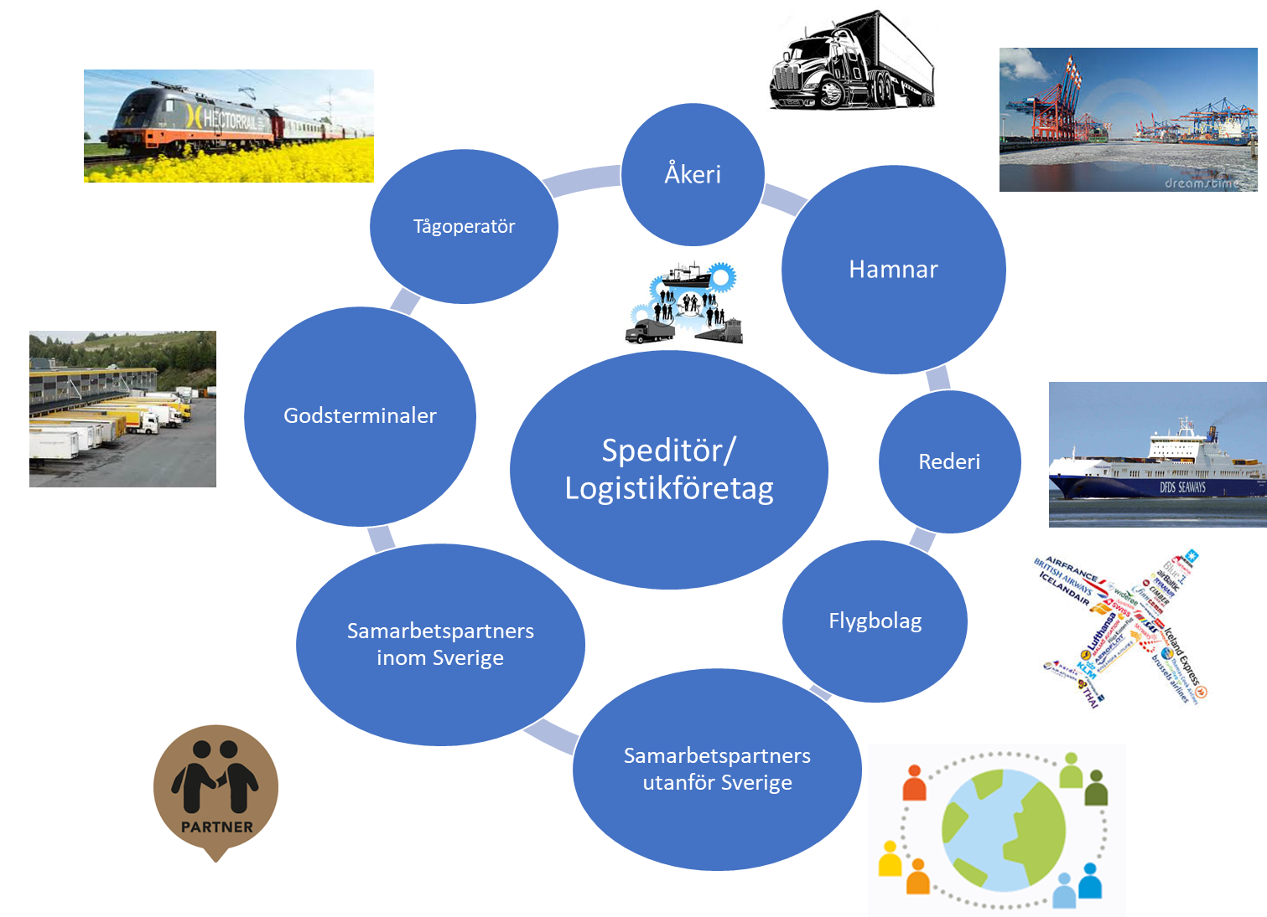
Logistics actors
Notes:
Use this is image

Slide 29
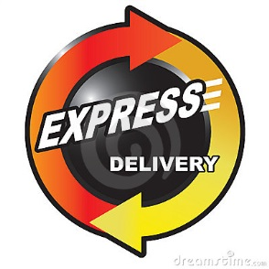
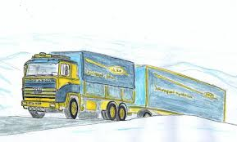

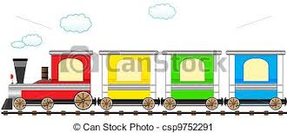
Logistics actors
Freight companies
Train operators
Shipping companies
Ports
Airports
Airline
Integrators
Logistics company
Forwarders
Freight terminals
Stock

Slide 30
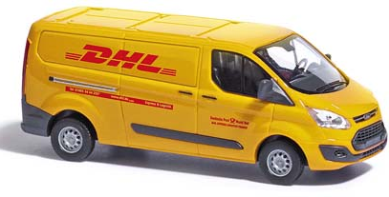
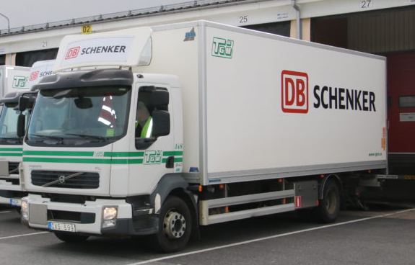
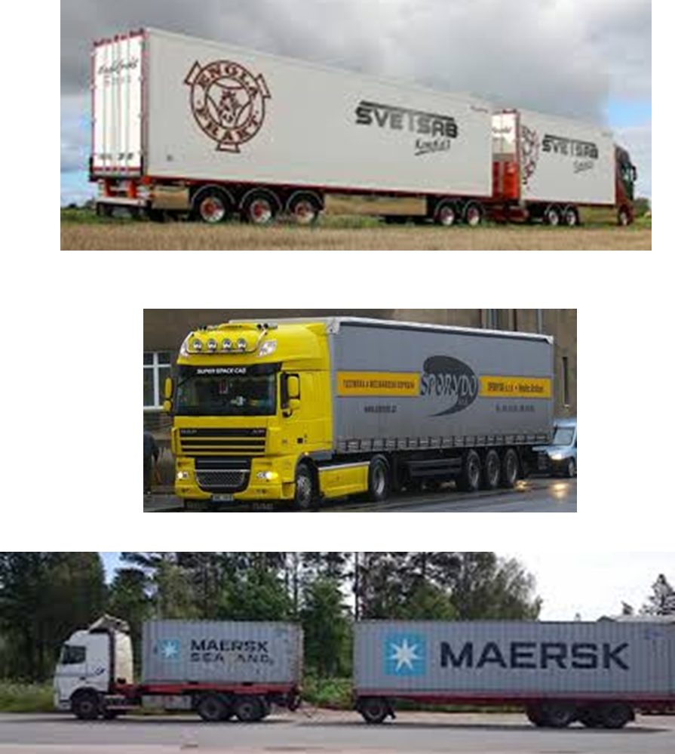
Logistics actors
Freight companies
Road transport
Local/regional
Distribution
Long-distance transport
National – domestic transport
International – foreign transport
Niche haulage companies
Undertaking
Thermal transports
Special transport

Slide 31
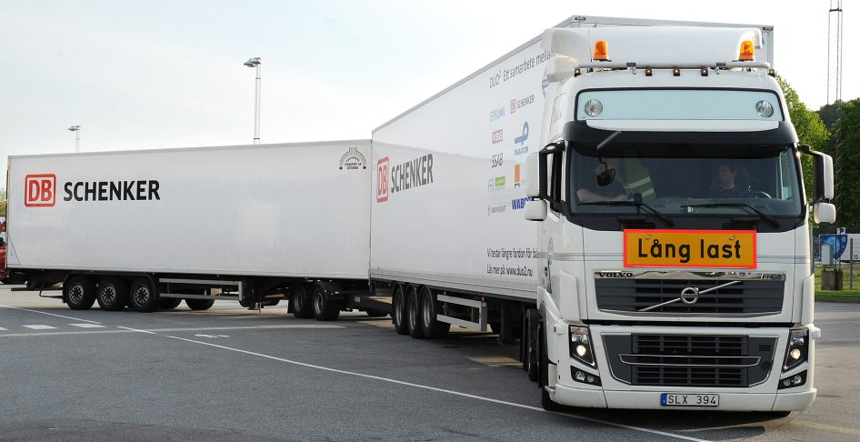
Logistics actors
Freight companies
Subcontractor to shipping companies, freight forwarders and logistics companies
Environmental impact
High environmental impact
Vehicles - Emissions
Fuel - Vehicles
Eco drive
Degree of filling
Route planning

Slide 32





Logistics actors
Domestic
"The big five "
Dedicated haulage companies
Subcontractors

Slide 33






Logistics actors
Broker of domestic transport
Network within the transport and logistics industry
Truck Centers
Economic Association
Skier

Slide 34





Logistics actors
Train operators
Drive trains, on specific routes
Provides locomotives and carriages
Owns no tracks
Swedish Transport Agency 90%
Intermodal transport
Freight wagon transport
Deregulation of the Swedish railway market in 1996
About 45 operators
Green Cargo
Hector Rail
Öresund train
TX Logistics
Subcontractor to, for example, Shipping Companies, Freight Forwarders and Logistics Companies
Environmental impact
Low

Slide 35
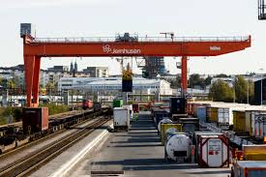
Logistics actors
Intermodal transport
Combi terminals
The central station for cargo carriers
Loading and unloading of cargo carriers
Load carriers = containers, trailers
The iron houses
Greencargo
The Sandahl companies
Mertz Transport
Railport Scandinavia
Port of Gothenburg
Harbor shuttles
Subcontractor Train operator

Slide 36
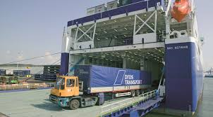
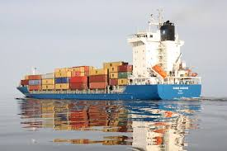
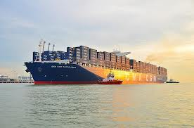
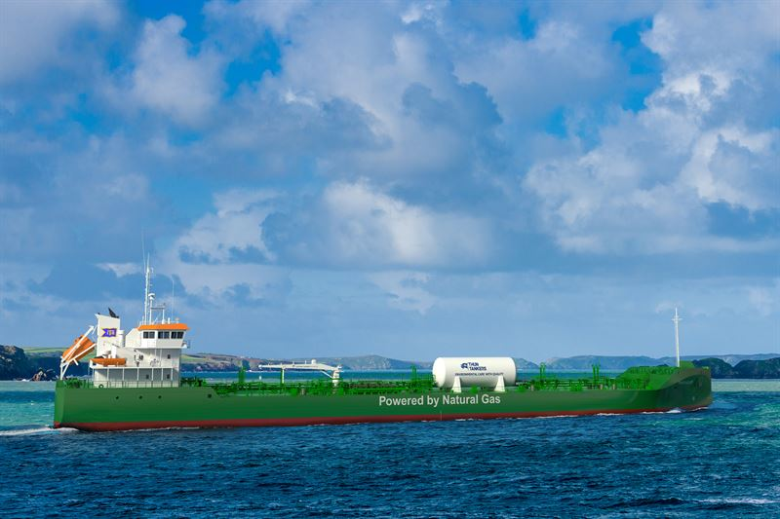
Logistics actors
Rudder vessel
Shipping companies
Sea transport
Provides load carriers
Collection and further transport
Feeder traffic
Subcontractor to freight forwarders, logistics companies
and companies
Environmental impact
Low
Large volume
Feeder ship
Container ship
Tanker

Slide 37
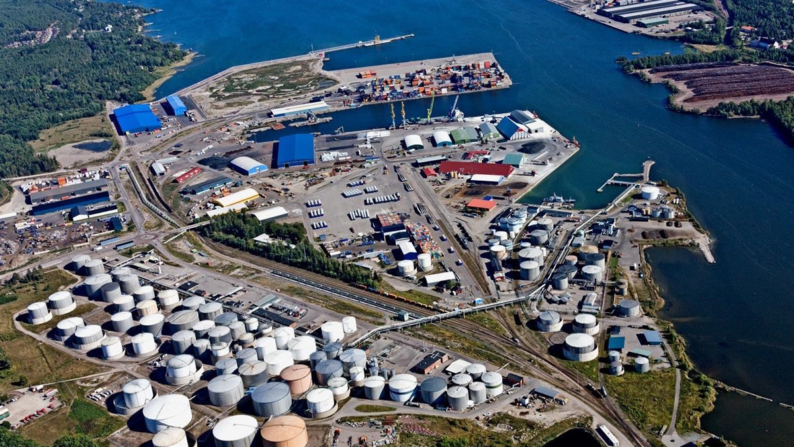
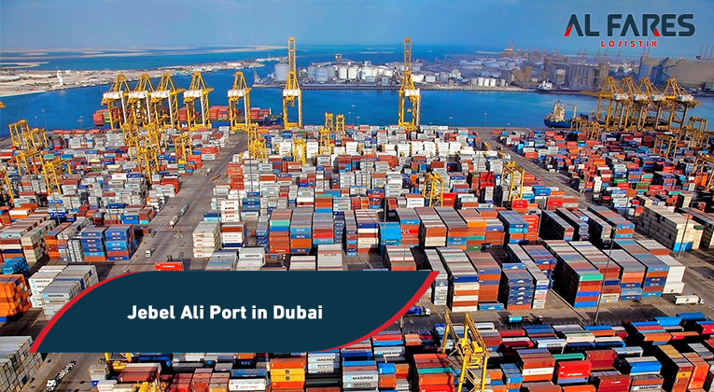
Logistics actors
Gävle port
Ports
Planning ship calls
Unloads and loads ships
Containers
Cars
Bulk
Energy
Security, scans and checks
Moves load carriers
Subcontractor to shipping companies, freight forwarders, goods owners and logistics companies
Environmental impact
Landström
Electricity at the berth
Electrified trucks
Self-driving vehicles

Slide 38
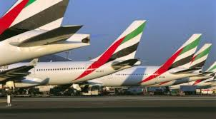
Logistics actors
Airline
Air freight
Subcontractor to freight forwarders and logistics companies
Environmental impact
High

Slide 39

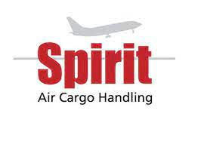

Logistics actors
Airport
Terminal company
Receives and delivers goods
Loads and unloads cargo carriers
Air containers, air pallets
Security, scans and checks
Action company
Transports goods between terminal and aircraft
Loading aircraft
Ground services
Subcontractor to airlines, freight forwarders and logistics companies
Malmö Airfreight Terminal

Slide 40
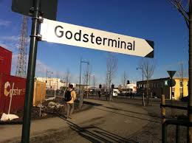
Logistics actors
Freight terminals
Godset's central station
Fast handling
Incoming goods
Outgoing goods
Subcontractor to
Forwarders

Slide 41
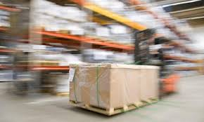
Logistics actors
Stock
Storage of goods
Unloads and loads cargo carriers
Book in and out transports
Places
Marks
Packs
Picks
Labels and documents
Subcontractor to
Forwarders
Logistics company
Goods owner

Slide 42



Logistics actors
Integrators
Package
Express
Standard packaging
EUR Pallet
Closed systems
IT
Own load carriers
Own vehicles
Environmental impact
High

Slide 43

Logistics actors
Logistics company
Operates domestic and international traffic
Based on subcontractors
All modes of transport
Own load carriers
Warehouse operations, external customers
Has its own global network
System controlled
Ownership structure
Post, Railway, Private business groups
Forwarding agent
Mediates all types of transport and logistics services
Has global partners
Competence-driven
Customer driven
Completely independent
Privately owned
One or more offices
Collaborators/Agents
Network
Agreement within the network
In common, both make extensive use of subcontractors

Slide 44


Slide 45
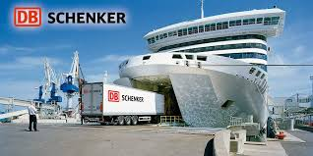
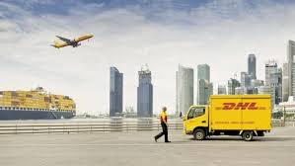

Logistics companies and forwarders
Background global, international logistics companies
1980 – 2000
Mergers
Purchases and acquisitions
Schenker DB
DHL
DSV

Slide 46
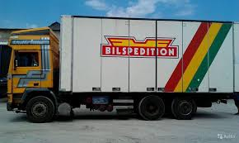
Logistics companies and forwarders
Background global, international logistics companies
In Sweden
Schenker DB
Founded in 1872 by Gotthard Schenker in Vienna
Deutsche Bahn – German state
1998 Acquisition of Bilspedition
Founded in 1936
Merger of five transport and forwarding companies
Founded at the beginning of the 20th century
The scan speed group
Schenker DB today
65,000 employees
150 countries
Has made several acquisitions of international transport and logistics companies

Slide 47
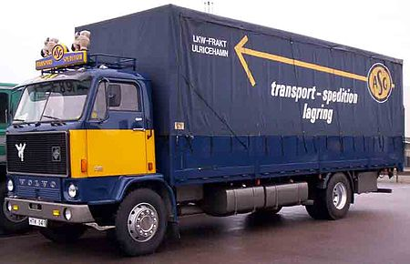
Logistics companies and forwarders
Background global, international logistics companies
DHL
Founded in 1969 in San Francisco
Deutsch Post – German state
In Sweden
2000 acquisition of ASG – Aktiebolaget Svenska Godscentraler
Founded in 1935
Owned by SJ 50%
30 – 40 offices in Sweden
150 hauliers connected
Foreign
Acquired by DHL in 2000
DHL today
380,000 employees
220 countries
Has made several acquisitions of international transport and logistics companies

Slide 48

Logistics companies and forwarders
Background global, international logistics companies
DSV
Founded in 1976 in Denmark
Merger of haulage companies
1989
Acquisition of DFDS Transport
Competitor
International expansion begins
10 – number of additional acquisitions
2019 Panalpina World Transport
55,000 employees
80 countries
Notes:
Both companies within the top ten

Slide 49
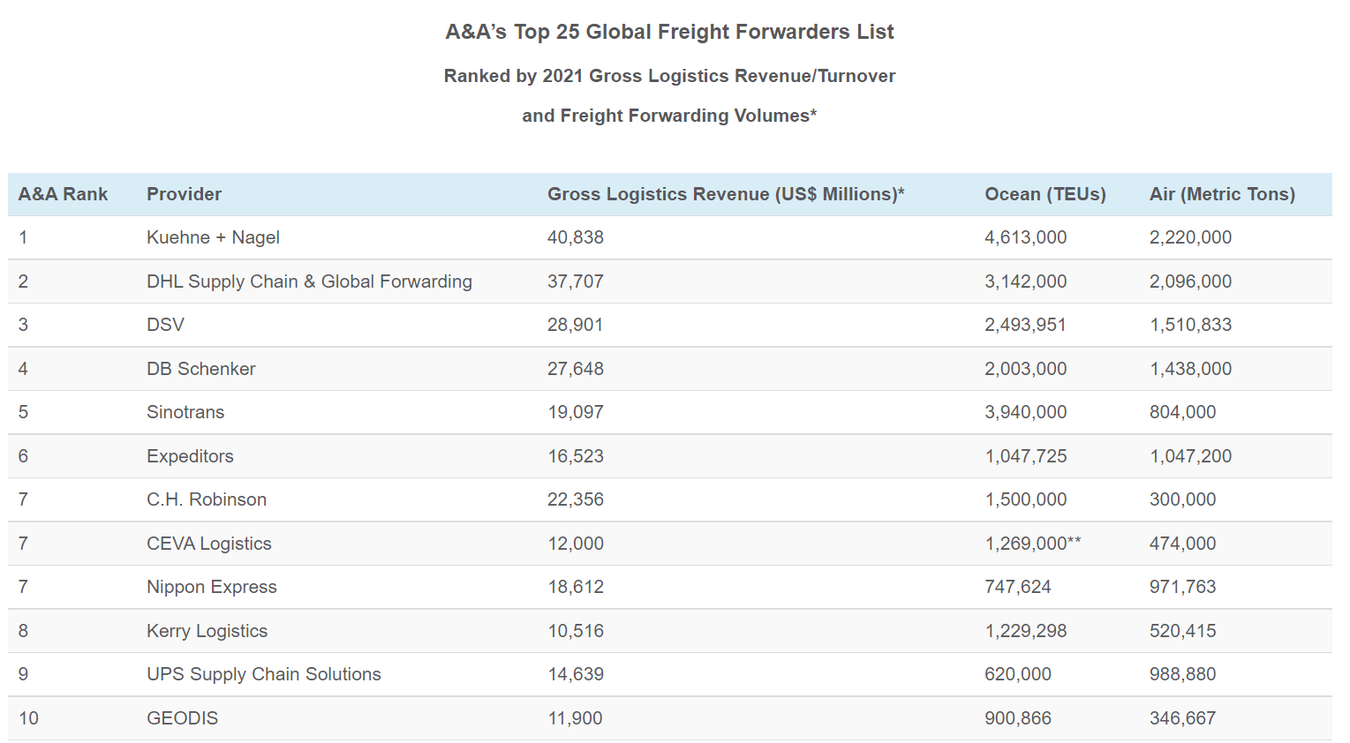

Slide 50
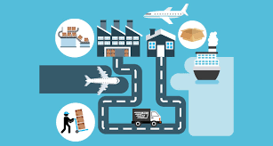
Logistics companies and forwarders
Logistics company
Own business
Domestic and international traffic
All modes of transport
Own load carriers
Warehouse operations
Large scale operation
Has its own global network
Transparent IT systems
System controlled
Market driven
Adapts to the operations of global companies
Endless oppotunities
Expanding through acquisitions

Slide 51

Logistics companies and forwarders
Global commodity owners depend on
Global logistics systems
Global digitization of logistics
A global logistics company caters for this
A global logistics company depends on
Large volume
Global merchandise owners
Large volumes
Global merchandise owners also need
Flexibility
The freight forwarder can see this to his credit

Slide 52

Logistics companies and forwarders
Logistics company
Organisation
Globally
Regionally
Parts of the world
Geographical international area
Local
Country
Business area

Slide 53

Logistics companies and forwarders
Completely independent
Privately owned
One or more offices
Collaborators/Agents
Network
Agreement within the network

Slide 54

Logistics companies and forwarders
DSV
http://www.gof.dsv.com/?gof=1&ContextItemId={000AE826-ADF0-4A97-94BD-AC83813D9377}&pagesize=50&freetext=Sweden&Continent={000AE826-ADF0-4A97-94BD-AC83813D9377}&sortfield=officetype&sort=descending&subsortfield =country

Slide 55

Logistics companies and forwarders
https://www.freja.com/se/kontakta-oss/kontaktpersons/

